Slide 1

Snake Game using Q-Learning & Reinforcement Learning
22AIE201 : Fundamentals of AI
Team 7 : G Prajwal Priyadarshan - 214 Kabilan K - 224 Kishore B - 227 Rahul L S - 248

Slide 2
Introduction
Artificial Intelligence (AI) has made significant advances, particularly in Reinforcement Learning (RL), which enables agents to make strategic decisions by interacting with environments. The Snake game, a well-known arcade game, serves as an excellent platform to test RL agents. In this project, we explore how an AI agent can learn and optimize its actions in the Snake game using Q-Learning, a core RL algorithm.
Reinforcement Learning (RL) is a branch of machine learning where an agent learns by interacting with an environment.
Q-Learning is a model-free RL algorithm that teaches the agent which action to take to maximize rewards.
Here model-free means the agent doesn't know what will happen if it moves right or left, it just tries and learns what works based on rewards (like getting food or hitting a wall).

Slide 3
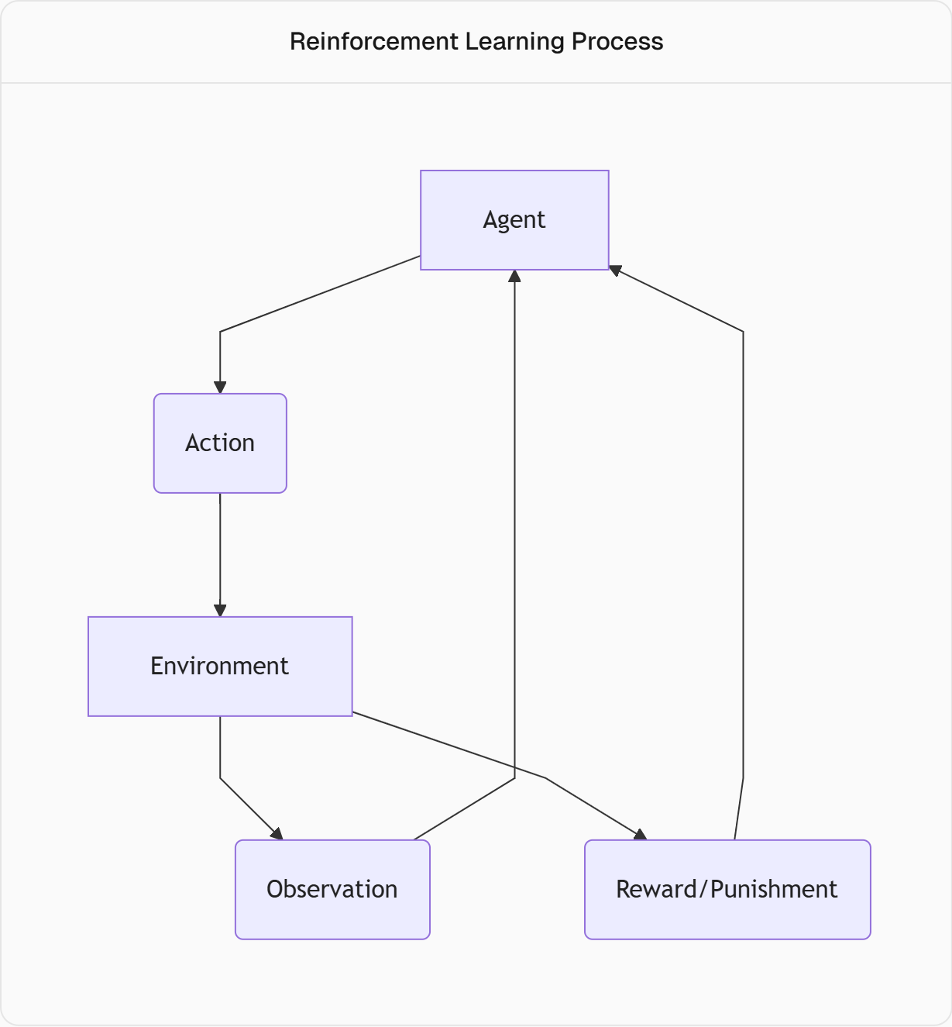

Slide 4
Motivation
This project presents the design and implementation of an intelligent agent that learns to play the Snake game using Q-Learning, a type of Reinforcement Learning (RL). The agent is trained to navigate a grid-based environment, collect food, and avoid self-collisions and walls. The game is built using Python’s Pygame, and the learning process is driven by rewards and penalties based on actions taken. This hands-on approach provides valuable insights into training AI agents, optimizing policies, and applying Q-Learning/DQN techniques to dynamic and strategic environments.

Slide 5
Base Paper - Developing Game AI for Classic Games Using Reinforcement Learning
For Snake (Q-learning)
Environment Setup:
States: Snake’s position, food location, and obstacles (walls or itself).
Actions: Four directions – up, down, left, right.
Q-Learning Algorithm:
Maintains a Q-table to store expected rewards for each state-action pair.
Uses ε-greedy strategy for balancing exploration and exploitation.
Applies experience replay to reuse past experiences for better learning.
🐍 Snake Game Agent :
Learns by interacting with the grid environment.
Gets positive rewards for eating food and negative rewards for crashing.

Slide 6
Literature Survey
Name | Author Name | Methods
Developing Game AI for Classic Games Using Reinforcement Learning | Shivam Gupta, 2024 | Q - Learning
Deep Q-Snake: An Intelligent Agent Mastering the Snake Game with Deep Reinforcement Learning | Debjyoti Ray, 2024 | DQN [ Deep Q Learning ]
A Deep Q-Learning based approach applied to the Snake game | Alessandro Sebastianelli, 2021 | DQN [ Deep Q Learning ]
Training a Reinforcement Learning Agent based on XCS in a Competitive Snake Environment | Johannes B¨ uttner, 2021 | XCS [ Extended Classifier System ]

Slide 7
Research Objectives
To design an environment-agent interaction model for the Snake game
To implement Reinforcement Learning for training the agent
To develop a suitable reward mechanism that drives optimal learning
To train the agent through repeated trials (episodes) and analyze learning performance
To demonstrate path optimization and intelligent decision-making in gameplay
To explore generalization and limitations of RL in real-time environments
To compare performance of Value based Reinforcement Learning types

Slide 8
Methodology

Slide 9
Define the Snake Game Environment
State: What the agent observes at each step.
Grid size
Snake’s head position
Food position
Direction of movement
Obstacles (walls, body)
Action Space:
3 discrete actions: [turn left , go straight, Turn Right] relative to the current direction.
Reward Function (crucial for learning):
+10 for eating food
-10 for dying
-0.01 small penalty for every step to Encourage shorter paths
Build the Q-learning Agent
Create a table (called Q-table)
This table helps the agent "remember" what to do in different situations.
Rows = situations (states), Columns = actions (turn left, go straight, turn right)
Teach the agent by giving rewards
After each move, the agent gets feedback (reward).
If the move was good (ate food) → reward is high ,If the move was bad (hit wall) → penalty is high
This reward helps the agent learn which actions are better over time.
Balance learning and trying
In the beginning, the agent tries random moves to explore the game.
Slowly, it starts choosing smarter moves it has learned (exploiting knowledge).
Repeat the process
The agent plays the game many times. Each time, it learns more from its mistakes and improves.
Visualize, Test and Evaluate the Agent
After training, we test how well the agent plays.
We visualize the game using pygame in python
Train the Agent
Let the agent play, firstly it explores, and overtime it starts to make smarter moves, this process is repeated until the agent improves

Slide 10
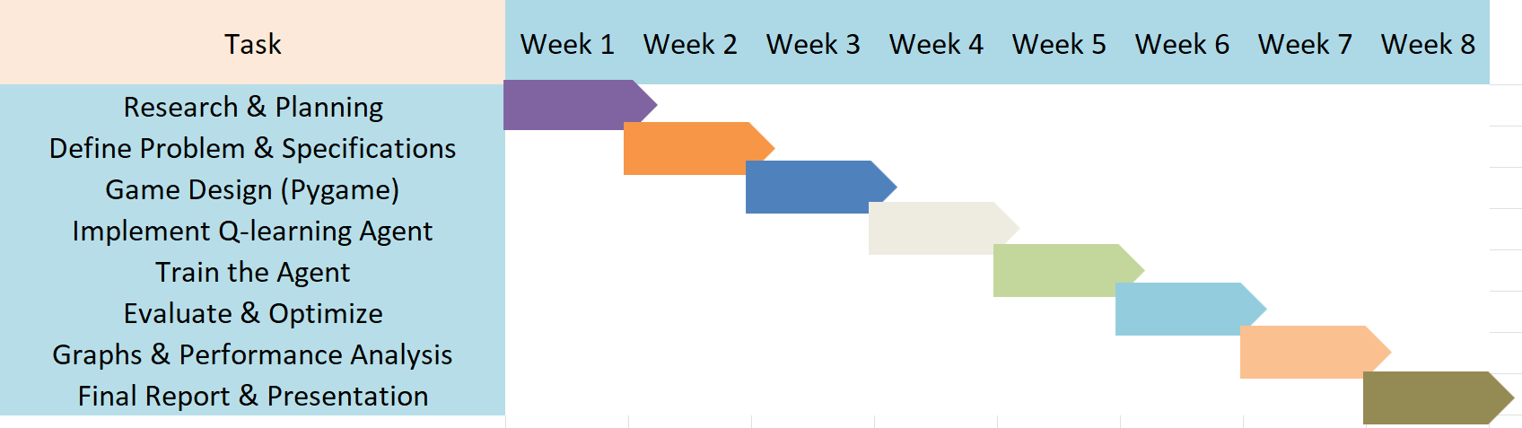
Gantt Chart

Slide 11
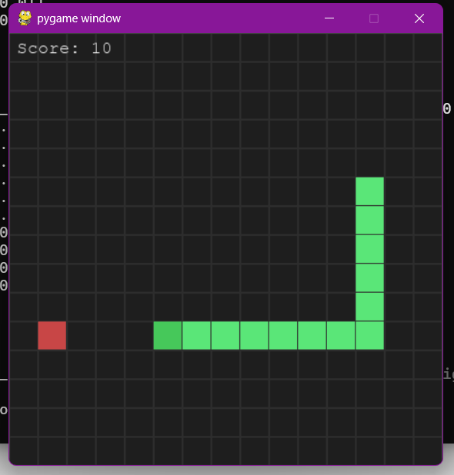
Work done until now

Slide 12
Core Functions
Grid Envirnment using Numpy
Q – Learning Agent
Training & Accuracy
Visualization with Pygame
Main Function
Environment (SnakeEnv)
Grid and Snake Initialization :
The snake game is built on a grid of adjustable size (width × height)
The snake is represented as a list of coordinates, starting at the grid’s center, facing right
Initial body = 3 blocks → [(cx, cy), (cx-1, cy), (cx-2, cy)]
Food is placed randomly in free cells (not overlapping with the snake)

Slide 13
State Encoding (11 binary features - 2048 possible states)
Danger bits [1-3] :
danger_ahead → 1 if moving forward causes collision
danger_right → 1 if turning right causes collision
danger_left → 1 if turning left causes collision.
*Direction bits [4-7] :
moving[UP] – snaking is currently heading up
moving[RIGHT] – if heading right
moving[DOWN] – if heading down
moving[LEFT] – if heading left
Food Position bit [8-11] : only one at a time
food_up → food is above head
food_right → food is to the right of head
food_down → food is below head
food_left → food is to the left of head
This gives 2,048 possible unique states [0 – 2047]

Slide 14

Action Space – there are 3 possible moves in it
0 = Forward → keep moving in the same direction
1 = Turn Left → snake rotates left relative to current direction
2 = Turn Right → snake rotates right relative to current direction
Total no of possible action space is 3.
Reward System
+10 → eating food
-10 → collision with wall or body
-10 → starvation (hunger limit exceeded)
-0.01 → each step penalty (to encourage efficiency)
Termination Condition
Collision → snake hits wall or itself
Hunger limit → no food eaten within hunger_limit

Slide 15
If food eaten
Add head, don’t remove tail → snake grows
Reward bonus +10
Score++, reset hunger counter, place new food
Else – how does the snake moves
Standard move: add head, remove tail; increment hunger counter.
Hunger death: terminal with -10 if exceeded limit

Slide 16
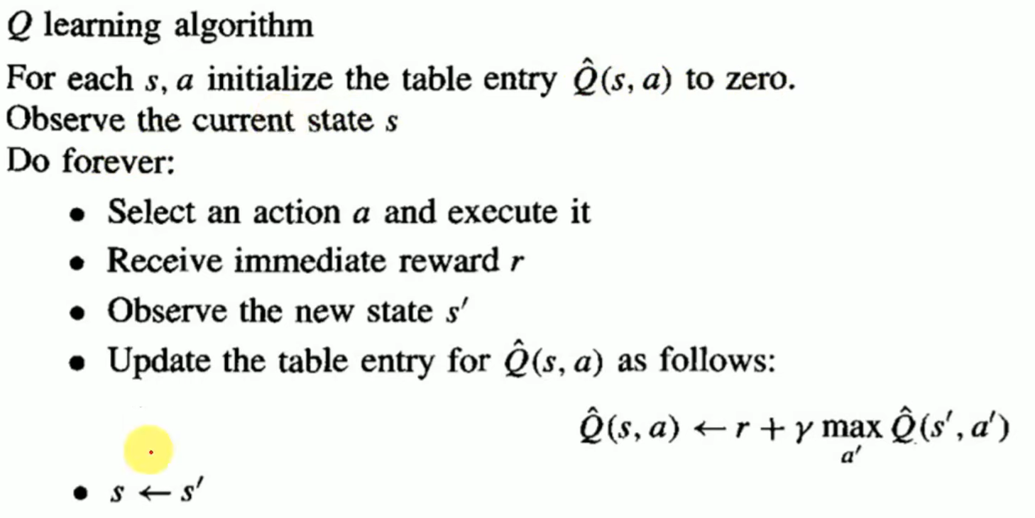
How Q – Learning Works

Slide 17

Q-Learning Agent (QAgent)
Uses a Q-table → a 2D array of shape [number of states × number of actions].
Initially, the Q-table is filled with zeros.
Action selection (ε-greedy strategy):
With probability ε, the agent explores (chooses a random action).
With probability 1-ε, it exploits (chooses the best action from the Q-table).
Learning (Bellman equation update):
α (alpha) → learning rate (how much to update old values).
γ (gamma) → discount factor (importance of future rewards).
ε → exploration rate (decays gradually from 1.0 to 0.01).
Used Tabular Q – Learning Agent – Q(s, a)
s – state – 2048 possible states
a – actions – 3 possible actions

Slide 18

Training Process
Training is done in episodes (games).
Each episode:
The snake starts in the center.
The agent repeatedly:
Observes the state.
Selects an action (explore or exploit).
Receives reward & next state from environment.
Updates the Q-table.
Episode ends when snake collides or starves.
Logging during training :
After every 100 episodes, prints:
Current episode score
Average score of last 100 episodes
Current exploration rate (ε).
Output : The final Q-table is saved to qtable.npy.
Accuracy : no of episodes where snake ate atleast one food / total no of episodes

Slide 19
Visualization (with Pygame)
Interactive Pygame Visualization: Utilizes Pygame to render a real-time, animated display of the Snake game, showcasing the Q-learning agent’s learned policy with a 20x20 grid (customizable via command-line arguments).
Clear Visual Elements: Draws the game state with distinct colors—red for food, green for the snake’s head, and lighter green for the body—overlaid on a gray grid, ensuring easy tracking of the snake’s movement and score.
Scaled Rendering: Converts logical grid coordinates to pixel coordinates using a cell size (default: 30 pixels), creating a 600x600 pixel window for a 20x20 grid, with 1-pixel gaps between cells for visual clarity.
Dynamic Score Display: Shows the current score in the top-left corner, updated in real-time as the snake eats food, with a 600ms pause and reset after each episode ends (e.g., collision or starvation).

Slide 20
Overall Key Features
Customizable grid size : --width and --height can be set before training/playing.
Customizabel episode : can mention no of --episodes or no of training
Separation of modules:
Environment (game logic)
Agent (Q-learning logic)
Training loop
Visualization (Pygame)
Rewards-based learning makes the snake smarter over time.
Easy upgrade path: The same environment can later be used with Deep Q-Learning (DQN using PyTorch).

Slide 21
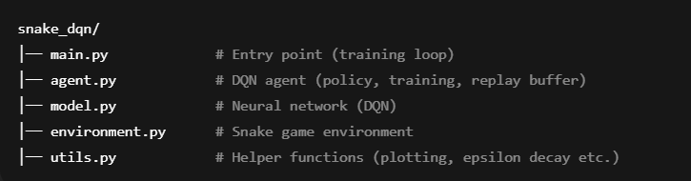
Future Work
Form a proper structure
Extending Q-Learning to Deep Q-Learning (DQN)
In the current implementation, a Q-table is used to store values for each state & action pair.
However, as the state space grows (e.g., larger grids, more complex environments), the Q-table becomes inefficient due to:
High memory requirements
Poor generalization (only exact states are stored
Deep Q-Learning (DQN) solves this by using a neural network as a function approximator to estimate Q-values:

Slide 22
Thank You

